Slide 1

Module 10: Improving Performance Using Caching
0/5
Analytics: Advanced Server Architect

Slide 2
Module Objectives
After completing this module you will be able to:
  Identify options to perform cache seeding and purging
  Execute cache seeding and purging
Why you need to know:
  Analytics performance can be greatly enhanced by using the cache
  Understanding cache seeding and purging is critical to maximizing cache performance and minimizing risks

Slide 3
Business Challenge
Leaving the Analytics cache off:
  Significantly reduces query performance
  Increases network traffic
  Increases database processing
  Increases Siebel Analytics Server processing overhead
However, an improperly maintained cache may:
  Contain stale data
  Contain irrelevant or rarely used data
  Contain data too specific to be useful in improving performance
Additionally, caching requires:
  High-speed, high-reliability disk space
  Cache administration

Slide 4
Business Solution
Turn off caching for infrequently accessed tables
  Prevents cache space from being “wasted”
Purge the cache periodically to remove stale or rarely used data
  Periodically purge the cache manually
  Use cache persistence timing to periodically purge frequently updated tables
  Use event polling tables to inform the system of changes to databases
  Purge the cache programmatically using ODBC functions
Seed the cache with relevant data
  Run a set of prebuilt queries to populate the cache with frequently used data
  Use Siebel Delivers to schedule a suite of reports that populate the cache

Slide 5
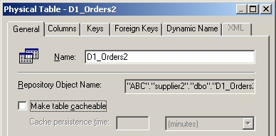
Adjusting Caching for Individual Tables
By default, all tables have caching enabled with infinite persistence time
  All data is cached, and nothing is purged until the cache runs out of space
Improve cache performance by disabling caching for infrequently queried tables
  Cache will fill more slowly
  Partially filled cache will not waste time checking against irrelevant metadata
Disabling caching on infrequently queried tables provides a slight performance boost

Slide 6
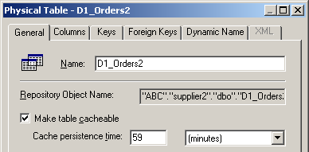
Adjusting Caching for Individual Tables Continued
Reduce the amount of stale data by setting cache persistence time
  For example, a sales table updated hourly should have a persistence time of 59 minutes
Set a cache persistence time to automatically purge data for this table from the cache after the specified period

Slide 7
Methods of Purging the Cache
0/3
Manual Purging
Automatic Purging
Programmatic Purging

Slide 8
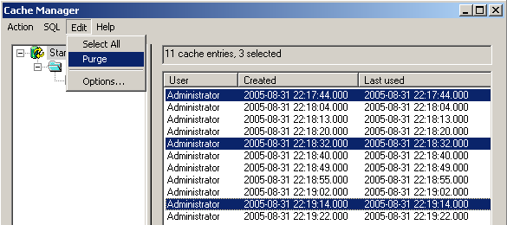
Manual Purging
1/3
Is performed using the Cache Manager in the Siebel Analytics Administration Tool
  Individual records represent individual queries
Provides the maximum flexibility in cache management
  Administrator decides which queries are least likely to be repeated
  Requires the greatest amount of human interaction
Select and manually purge records for greatest control

Slide 9
Automatic Purging
2/3
Is performed using an event polling table
  Updates to the underlying database tables stored in a polling table
  Analytics Server periodically polls this table and invalidates any cache entries corresponding to the updated tables
Requires setting up an event polling table and configuring the Siebel Analytics Server to support event polling

Slide 10
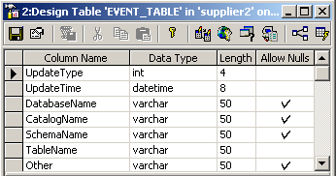
Setting Up the Event Polling Table
2/3
Create an event table in a database accessible to the Siebel Analytics Server
  Schema for the table is provided in the Siebel Analytics Server Administration Guide
  A single table in a single database may be used, even if multiple databases are accessed by Siebel Analytics
The event polling table must include these seven columns and must be located in a database accessible to the Siebel Analytics Server

Slide 11
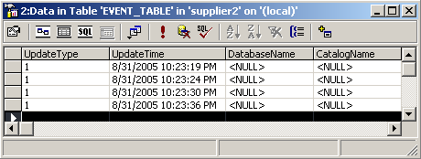
Populating the Event Polling Table
2/3
Configure each database to insert a row into the event table whenever a table in that database is updated
  Use database triggers if possible
  Alternatively, include SQL INSERT statements in extraction and load scripts
Configure databases to add a row to the event table every time a table is modified

Slide 12
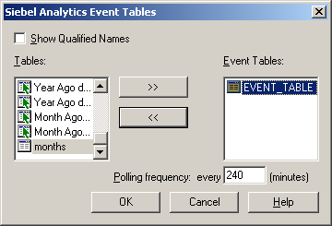
Configuring the Analytics Server for Event Polling
2/3
Add the event table to the Physical layer in the Siebel Analytics Administration Tool
Set polling frequency for event table under Tools > Utilities
  Every polling period, table is read, relevant cache entries are purged, and then referenced table rows are deleted

Slide 13
Multiple Event Polling Tables
2/3
Multiple event polling tables can be set up
  For example, an event table could be put in each database accessed by the Siebel Analytics Server
Each event polling table may have a different period

Slide 14
Programmatic Purging
3/3
Is performed using ODBC extension functions
  Data warehouse administrator embeds functions in Extract, Transform, and Load (ETL) task
  Call these functions just like normal SQL calls from within scripts
Purge by query, table, database, or entire cache
  SAPurgeCacheByQuery
    Call SAPurgeCacheByQuery(‘select lastname, firstname from employee where salary > 100000’ );
  SAPurgeCacheByTable
    Call SAPurgeCacheByTable( ‘DBName’, ‘CatName’, ‘SchName’, ‘TabName’ );
  SAPurgeAllCache
    Call SAPurgeAllCache();
  SAPurgeCacheByDatabase
    Call SAPurgeCacheByDatabase( ‘DBName’ );

Slide 15
Seeding the Cache
Is performed by running prebuilt queries or reports
Should be done immediately after purging
  Ensures that seed data will be stored in the cache
Run the queries:
  Manually in Siebel Answers
  Using Siebel Delivers to schedule queries or reports to run at a specified time
Cache is automatically populated when queries run

Slide 16
Cache Seeding Guidelines
Use queries that require a great deal of database or server processing
  For example, queries with many joins or a great deal of sorting
Use queries with no WHERE clauses that will populate many subqueries
  For example, a seed statement of
  SELECT User, SR from SERVICE_REQUESTS
  will provide cache hits for all queries of the form
  SELECT User, SR from SERVICE_REQUESTS
  WHERE user = xxx
Use most commonly used queries
  Caching a query with 23 joins that is called once a day is not as important as caching a query with no joins that is called 5,000 times a day
Use SELECT lists with no expressions

Slide 17
Summary
This module showed you how to:
  Identify options to perform cache seeding and purging
  Execute cache seeding and purging

Slide 18
Lab
In the lab you will:
  Perform steps to populate the cache
  Perform steps to purge the cache

